Slide 1
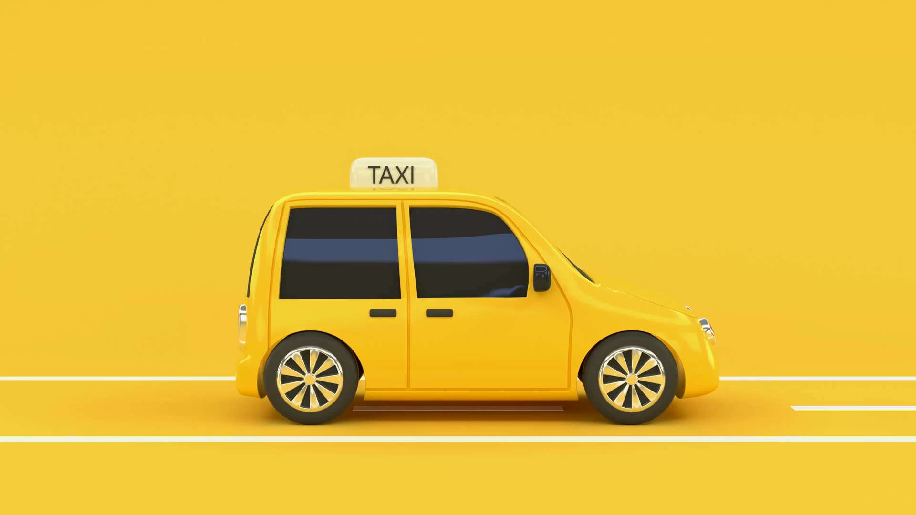
Database Group Project Semester 1

Slide 2
Acknowledgement
We wish to Express our sincere gratitude to S.P Jain School of Global Management for providing us facilities and encouragement for completing the Group Project on time. Further I wish to thank our Databases Professor Sunil Lakdawala for his tireless efforts to teach us and guide us throughout the classes. Lastly, We are thankful to god, the creator and Preserver for his blessings.
By,
Devashish Upadhyay, Kushal Jain, Jay Bhutoria and Rishit Kapadiya.
(BACHELOR’S OF DATA SCIENCE)

Slide 3
Content
Overview
Entities
ERD
Data Dictionary
DB Design
Creating Tables
Populating Data
Creating View
Creating Index
Working Of the Project

Slide 4

Overview
This application helps you book a virtual cab.
All cab booking operators like Ola, Uber etc., uses a dynamic database at the backend
Information is collected, updated and stored in the database using programming languages like python, javascript and more.

Slide 5

Working of the Project
Creating a well-organized schema
Generating a unique API token for Telegram Chatbot
Making a database using SQL server 2019
Connecting to database using python
Connecting to bot using python
Rigorous testing of the chatbot

Slide 6

Assumptions
1 car can only be driven by 1 driver.
1 cab can only be booked by 1 person at a time.
A person can only book 1 cab.

Slide 7
Entities
Driver_Data
Driver_ID
Driver_Name
Driver_PhNo
Customer_Data
Customer_ID
Customer_Name
Customer_PhNo
Customer_Pincode
Customer_Email
Car_Data
Car_No
Car_Model
Car_Colour
Driver_ID
Booking_Data
Booking_ID
Car_No (FK)
Driver_ID (FK)
Customer_ID (FK)

Slide 8

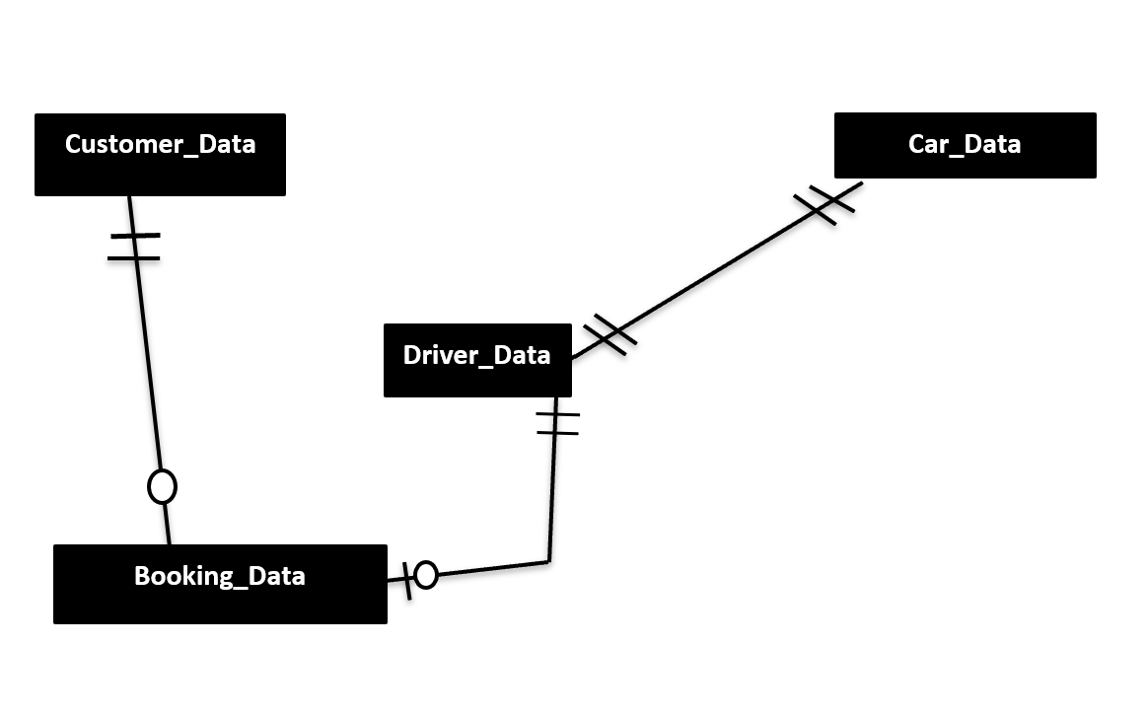
ERD

Slide 9
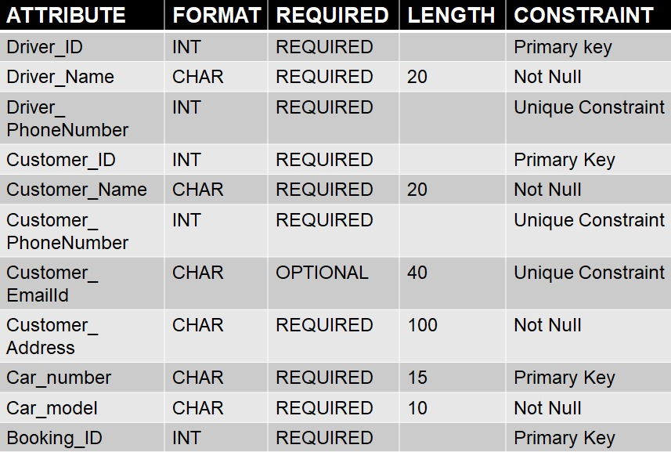
Data Dictionary

Slide 10
Tables
Driver_Data
Driver_ID
Driver_Name
Driver_PhoneNumber
Customer_Data
Customer_ID
Customer_Name
Customer_PhoneNumber
Customer_Address
Customer_EmailID
Car_Data
Car_No
Car_Model
Car_Colour
Driver_ID
Booking_Data
Booking_ID
Driver_ID
Customer_ID

Slide 11
CREATING TABLE Driver_Data
Driver_Data
Driver_ID
Driver_Name
Driver_PhoneNumber
CREATE TABLE dbo.Driver_Data (
Driver_ID int NOT NULL,
Driver_Name char(20) NOT NULL,
Driver_PhoneNumber int NOT NULL,
PRIMARY KEY (Driver_ID),
CONSTRAINT PhonenoCheck CHECK (Driver_PhoneNumber<9999999999)
);

Slide 12
CREATING TABLE Customer_Data
CREATE TABLE dbo.Customer_Data (
Customer_ID int NOT NULL,
Customer_Name char(20) NOT NULL,
Customer_PhoneNumber int NOT NULL,
Customer_EmailID char(40) NOT NULL,
Customer_Address char(100) NOT NULL,
PRIMARY KEY (Customer_ID),
CONSTRAINT Phonenocheckcust CHECK (Customer_PhoneNumber<9999999999),
);
Customer_Data
Customer_ID
Customer_Name
Customer_PhoneNumber
Customer_Address
Customer_EmailID

Slide 13
CREATING TABLE Car_Data
CREATE TABLE dbo.Car_Data (
Car_Number char(15) NOT NULL,
Car_Model char(10) NOT NULL,
Car_Colour char(10) NOT NULL,
Driver_ID int,
PRIMARY KEY (Car_Number),
FOREIGN KEY (Driver_ID)
REFERENCES Driver_Data(Driver_ID)
);
Car_Data
Car_Number
Car_Model
Car_Colour
Driver_ID(FK)

Slide 14
CREATING TABLE Booking_Data
CREATE TABLE dbo.Booking_Data (
Booking_ID int NOT NULL,
Customer_ID int,
Driver_ID int,
PRIMARY KEY (Booking_ID),
FOREIGN KEY (Driver_ID)
REFERENCES Driver_Data(Driver_ID),
FOREIGN KEY (Customer_ID)
REFERENCES Customer_Data(Customer_ID),
);
Booking_Data
Booking_ID
Driver_ID (FK)
Customer_ID (FK)

Slide 15
POPULATING TABLE Driver_Data
Driver_Data
Driver_ID
Driver_Name
Driver_PhoneNumber
INSERT INTO dbo.Driver_Data (Driver_ID,Driver_Name,Driver_PhoneNumber)
VALUES (1,'KUSHAL JAIN',95647),
(2,'DEVASHISH UPADHYAY',45678),
(3, 'RISHIT KAPADIYA',21354),
(4,'JAY BHUTORIA',85461);

Slide 16
POPULATING TABLE Customer_Data
INSERT INTO dbo.Customer_Data (Customer_ID,Customer_Name,Customer_PhoneNumber,Customer_Address,Customer_EmailID)
VALUES (56,'NANCY MAYER',956470,'B-64 MUMBAI','nacy@ok.com'),
(65,'SURESH',434478,'B-454 UDAIPUR','suresh@ok.com'),
(89,'KAILASH',956450,'N-956 DELHI','kailash@ok.com'),
(15,'Donald Trump',923140,'G-64 JAIPUR','donaldduck@ok.com');
Customer_Data
Customer_ID
Customer_Name
Customer_PhoneNumber
Customer_Address
Customer_EmailID

Slide 17
POPULATING TABLE Car_Data
INSERT INTO dbo.Car_Data (Car_Number, Car_Model,Car_Colour, Driver_ID)
VALUES ('RJ27OK1236','BMW','BLUE',1),
('MP57JK1289','TOYOTA','BLACK',2),
('MH01LK4886','TESLA','PURPLE',3);
Car_Data
Car_Number
Car_Model
Car_Colour
Driver_ID

Slide 18
POPULATING Booking_Data
INSERT INTO dbo.Booking_Data(Booking_ID,Driver_ID,Customer_ID)
VALUES (655,1, 56),
(546,2, 15);
Booking_Data
Booking_ID
Driver_ID
Customer_ID

Slide 19
CREATING VIEW
CREATE VIEW [BOOKINGS] AS SELECT Customer_ID, Driver_ID FROM dbo.Booking_Data
;

Slide 20
CREATING INDEX
CREATE INDEX idx_main
ON dbo.Customer_Data (Customer_ID,Customer_NAME)
;

Slide 21
REFERENCES
David Kroenke, “Database Processing”, 13th edition
Telegram API Documentation
Python3 Documentation

Slide 22

THANK YOU
From Devashish Upadhyay, Kushal Jain, Rishit Kapadiya and Jay Bhutoria

